Slide 1
Is Learning Feasible?
Example of learning feasibility
Bin example in a probability approach
Generalization on the feasibility of learning

Slide 2
Recap
We saw in the previous chapter how the basic mechanics on machine learning relate to each other, and we also saw that the premise of machine learning is to discover the underlying system (the unknown target function f) using just a finite set of observations. This is a major point, but what does guaranty that we can generalize an infinite real set using a finite training set?
if I use a dataset on cancer patients from Michigan to do some classification tasks it should give me the same performance if I used a dataset from cancer patients in japan).

Slide 3
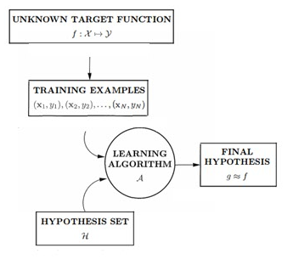

Slide 4
Learning and memorizing
The target function f is the object of learning. The most important assertion about the target function is that it is unknown.
When we get the training data D, we know the value of f on all the points in D. This doesn't mean that we have learned f, since it doesn't guarantee that we know anything about f outside of D. We know what we have already seen, but that's not learning. That's memorizing.
In learning when we get the hypothesis g, we disregard the data, why? Because we used it to extract the underlying process that governs its distribution, while in memorizing, the model tends to panic in facing new observations.

Slide 5
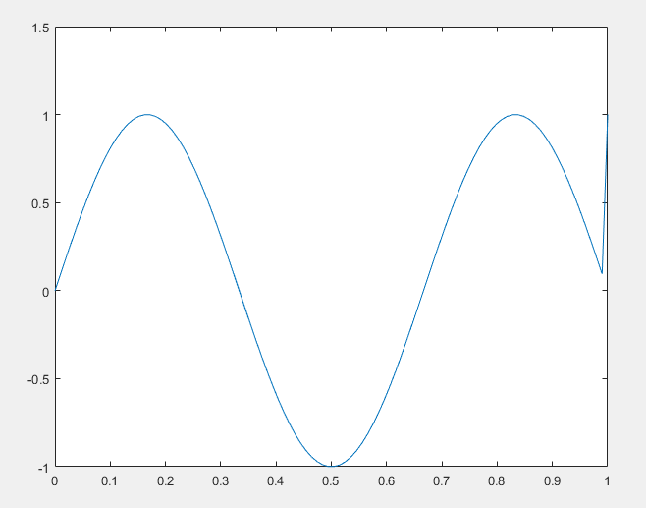
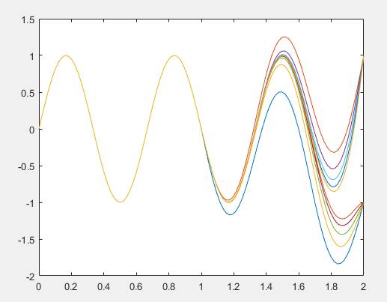
Let’s see we want to approximate some function L but we only know its values on a finite set D
there are an infinite amount of functions that takes the same value as L in the known domain but takes different values outside of that domain

Slide 6
we have a dilemma!
The whole purpose of learning is to be able to predict the value of f on points that we haven't seen before. The quality of the learning will be determined by how close our prediction is to the true value. So regardless how g approach f it can agree or disagree with the target, depending on which f in the family of “fn” is turns out to be the true target.

Slide 7
Generalizing using samples (example Bins)
We will show that we can indeed infer something outside D using only D, but in a probabilistic way.
What we infer may not be much compared to learning a full target function, but it will establish the principle that we can reach outside D.
Forget about the learning model
we will take it to the general learning problem and pin down what we can and cannot learn.

Slide 8
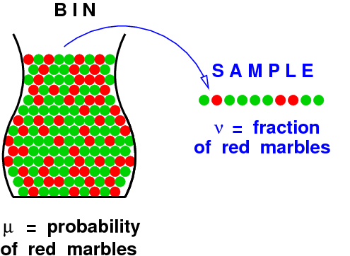
The Bin
Consider a bin that contains red and green marbles. The proportion of red and green marbles in the bin is such that if we pick a marble at random, the probability that it will be red is µ and the probability that it will be green is 1 - µ.
We assume that the value of µ is unknown to us
If We pick a random sample of N independent marbles (with replacement) from this bin, and observe the fraction v of red marbles within the sample. What does the value of v tell us about the value of µ?

Slide 9
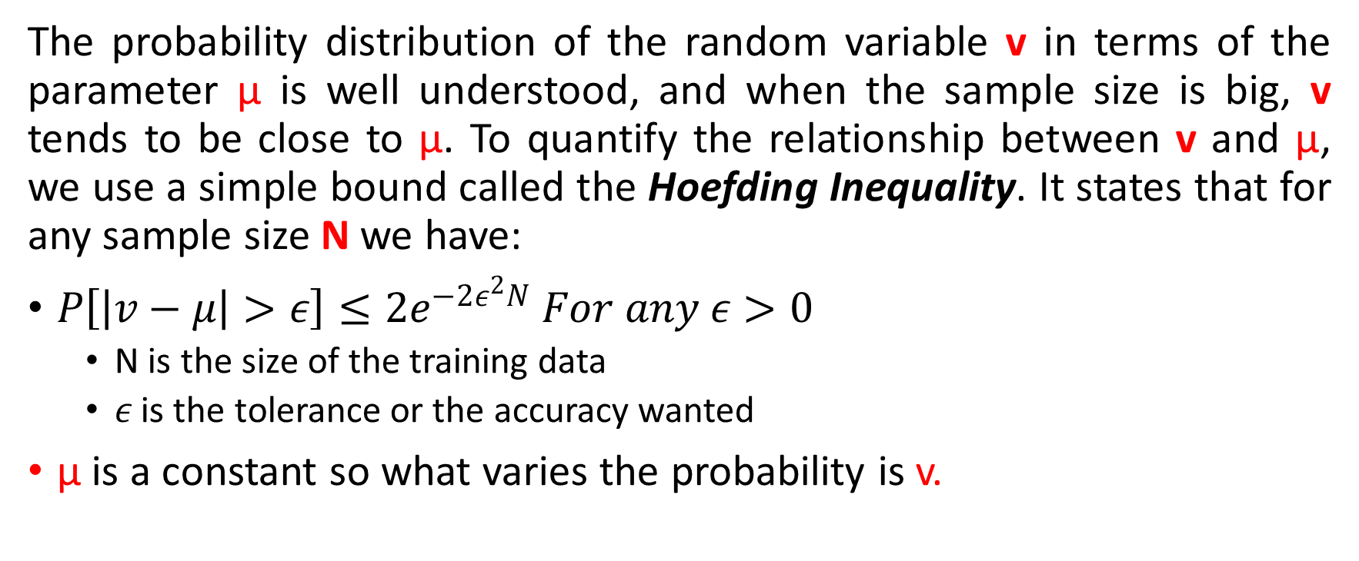
Hoefding Inequality
The probability distribution of the random variable v in terms of the parameter µ is well understood, and when the sample size is big, v tends to be close to µ. To quantify the relationship between v and µ, we use a simple bound called the Hoefding Inequality. It states that for any sample size N we have:
$P\left[\left|v−μ\right|>ε\right]≤2e^{−2ε^{2}N} For any ε>0$
N is the size of the training data
$ε$ is the tolerance or the accuracy wanted
µ is a constant so what varies the probability is v.

Slide 10
Relation to the learning problem
(Keep forgetting the learning Algorithm)
in our example µ is an unknown constant but our f is an unknown function, but the two situation can be linked if we illustrate the procedures as follow:
The red marbles represent the instances (observations) that for a given h in H, such as h different of f
The green marbles represent the opposite i.e. the instances where f=h

Slide 11
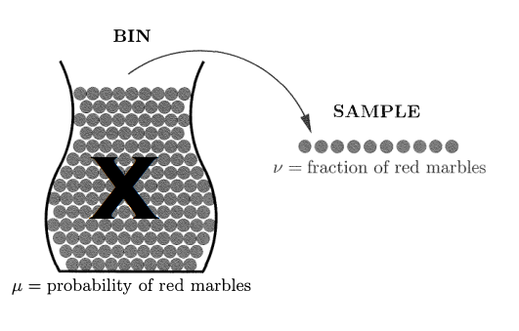
in the bin we knew what the colors were, we can see them, here we don’t Because in our hypothesis f is unknown.
what we know are its values (or its characteristic) at a training set.
So we choose the entire bin as the space X.
if we pick x at random according to some probability distribution P over the input space X, we know that x will be red with some probability, call it µ, and green with probability 1 - µ. Regardless of the value of µ, the space X now behaves like the bin.

Slide 12
Example
We want to binary classify car images i.e. if a picture is car or not, the space X will be the entire car pictures ever taken since the taken of pictures of cars began of any model, type, shape or year. The sample will be our dataset (CIFAR-1000, CIFAR-100, etc.). We pick our learning model as The Inception model, if we go back to our bin metaphor, we pick a picture x, the model give us a prediction .i.e. h(x), if for that particular picture, the target function and the h agree i.e. f(x)=h(x), we color it green else we color it red.

Slide 13
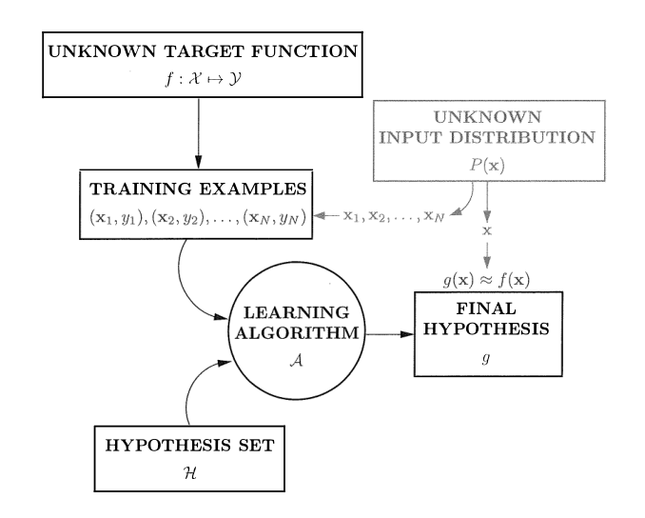
The final learning problem
The learning problem is now reduced to a bin problem, under the assumption that the inputs in D are picked independently according to some distribution P on X.
Any P will translate to some µ in the equivalent bin. Since µ is allowed to be unknown, P can be unknown to us as.
Now the by adding this information to the learning problem, it will be transform

Slide 14
Quick Recap
Using v to predict µ tells us something about f, although it doesn't tell us what f is. What µ tells us is the error rate h makes in approximating f. If v happens to be close to zero, we can predict that h will approximate f well over the entire input space. If not, we are out of luck.
What we said so far was good for “a given h” a single h i.e. a single bin, now let us see if we can extend the bin equivalence to the case where we have multiple hypotheses in order to capture real learning.

Slide 15
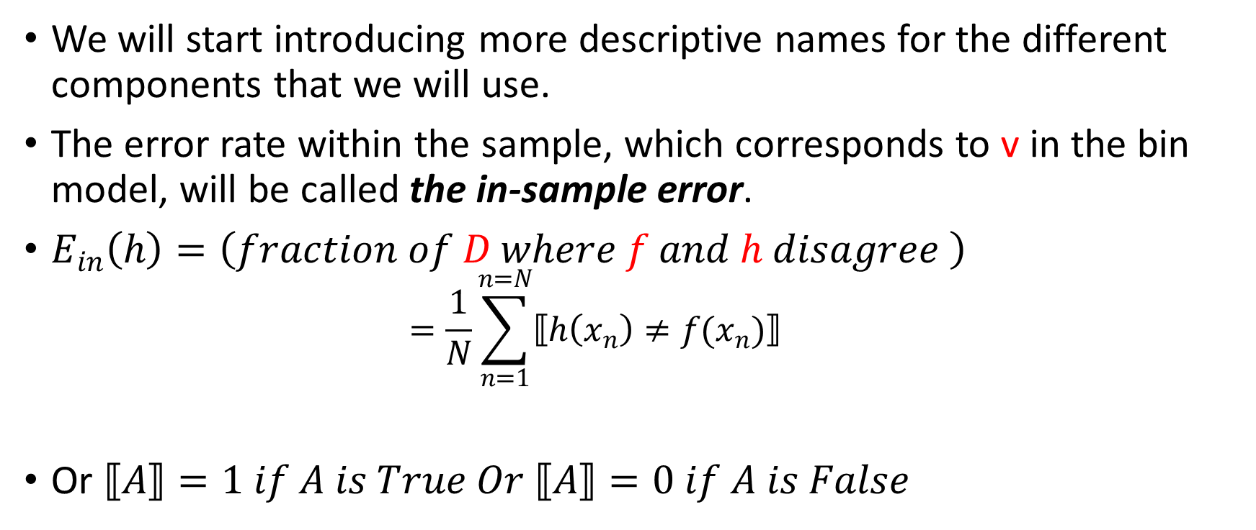
Mathematical formalization
We will start introducing more descriptive names for the different components that we will use.
The error rate within the sample, which corresponds to v in the bin model, will be called the in-sample error.
$E_{in}\left(h\right)=\left(fraction of D where f and h disagree \right)$
$$=\frac{1}{N}\sum_{n=1}^{n=N}{⟦h\left(x_{n}\right)≠f(x_{n})⟧}$$
Or $⟦A⟧=1 if A is True Or ⟦A⟧=0 if A is False$

Slide 16
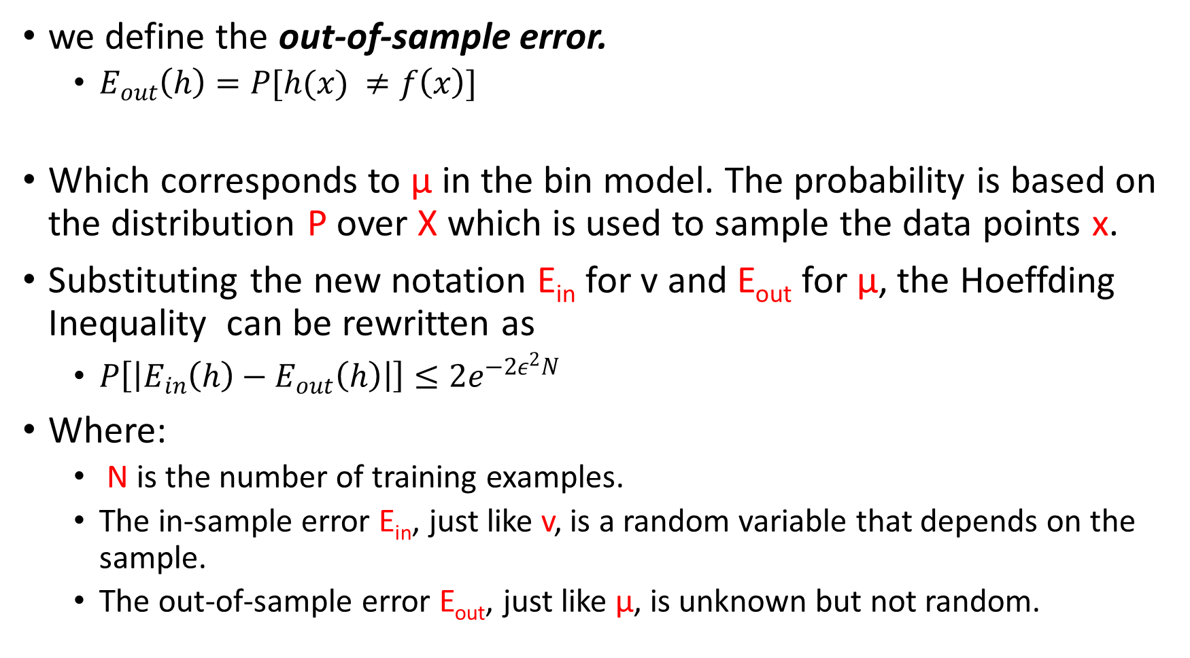
we define the out-of-sample error.
$E_{out}\left(h\right)=P[h(x) ≠f\left(x\right)]$
Which corresponds to µ in the bin model. The probability is based on the distribution P over X which is used to sample the data points x.
Substituting the new notation E_{in} for v and E_{out} for µ, the Hoeffding Inequality can be rewritten as
$P\left[\left|E_{in}\left(h\right)−E_{out}\left(h\right)\right|\right]≤2e^{−2ε^{2}N}$
Where:
N is the number of training examples.
The in-sample error E_{in}, just like v, is a random variable that depends on the sample.
The out-of-sample error E_{out}, just like µ, is unknown but not random.

Slide 17
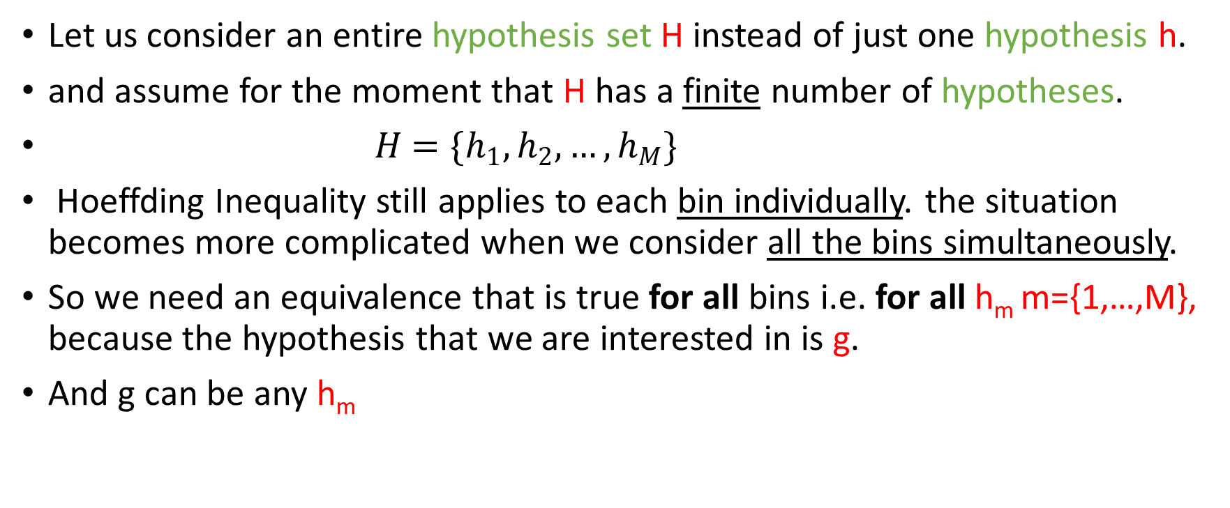
Another one!!
Let us consider an entire hypothesis set H instead of just one hypothesis h.
and assume for the moment that H has a finite number of hypotheses.
$H=\{h_{1},h_{2},…,h_{M}\}$
Hoeffding Inequality still applies to each bin individually. the situation becomes more complicated when we consider all the bins simultaneously.
So we need an equivalence that is true for all bins i.e. for all h_{m} m={1,…,M}, because the hypothesis that we are interested in is g.
And g can be any h_{m}

Slide 18
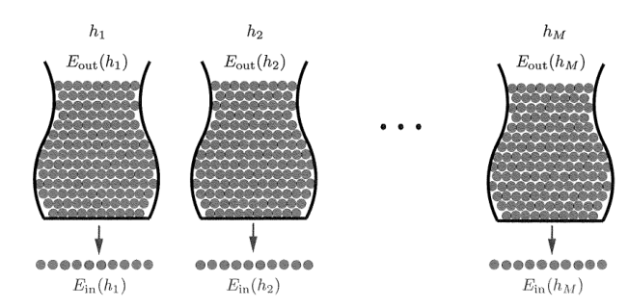
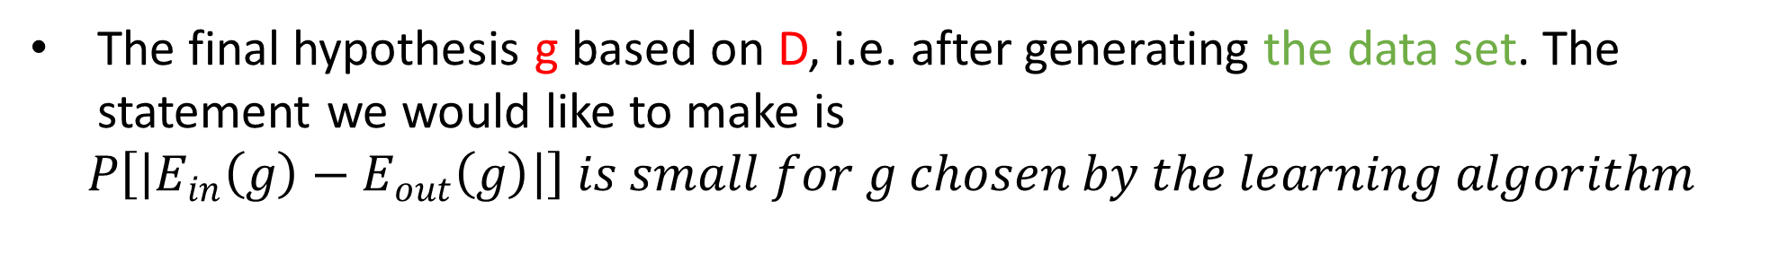
The hypothesis g is not fixed ahead of time before generating the data, because which hypothesis is selected to be g depends on the data. So, we cannot just plug in g for h in the Hoeffding inequality.
X
X
X
The final hypothesis g based on D, i.e. after generating the data set. The statement we would like to make is
$$P\left[\left|E_{in}\left(g\right)−E_{out}\left(g\right)\right|\right] is small for g chosen by the learning algorithm$$

Slide 19
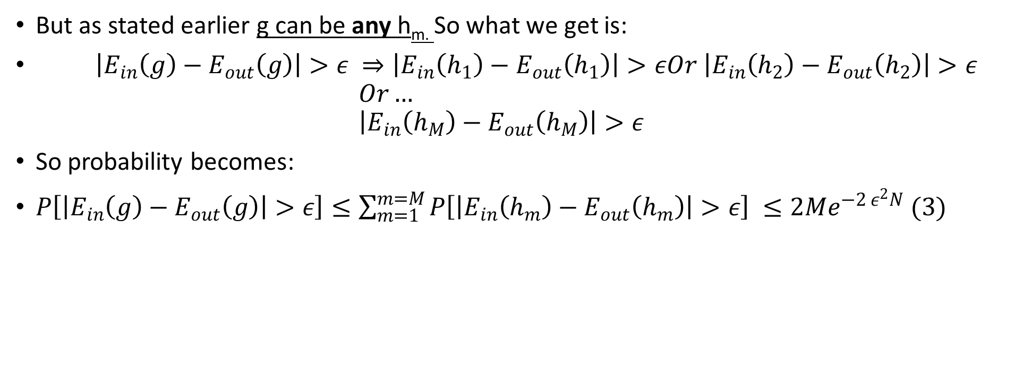
The solution
But as stated earlier g can be any h_{m.} So what we get is:
$\left|E_{in}\left(g\right)−E_{out}\left(g\right)\right|>ε ⇒\left|E_{in}\left(h_{1}\right)−E_{out}\left(h_{1}\right)\right|>εOr \left|E_{in}\left(h_{2}\right)−E_{out}\left(h_{2}\right)\right|>ε$ $Or…$ $\left|E_{in}\left(h_{M}\right)−E_{out}\left(h_{M}\right)\right|>ε$
So probability becomes:
$P\left[\left|E_{in}\left(g\right)−E_{out}\left(g\right)\right|>ε\right]≤\sum_{m=1}^{m=M}{P\left[\left|E_{in}\left(h_{m}\right)−E_{out}\left(h_{m}\right)\right|>ε\right]} ≤2Me^{−2 ε^{2}N} (3)$

Slide 20
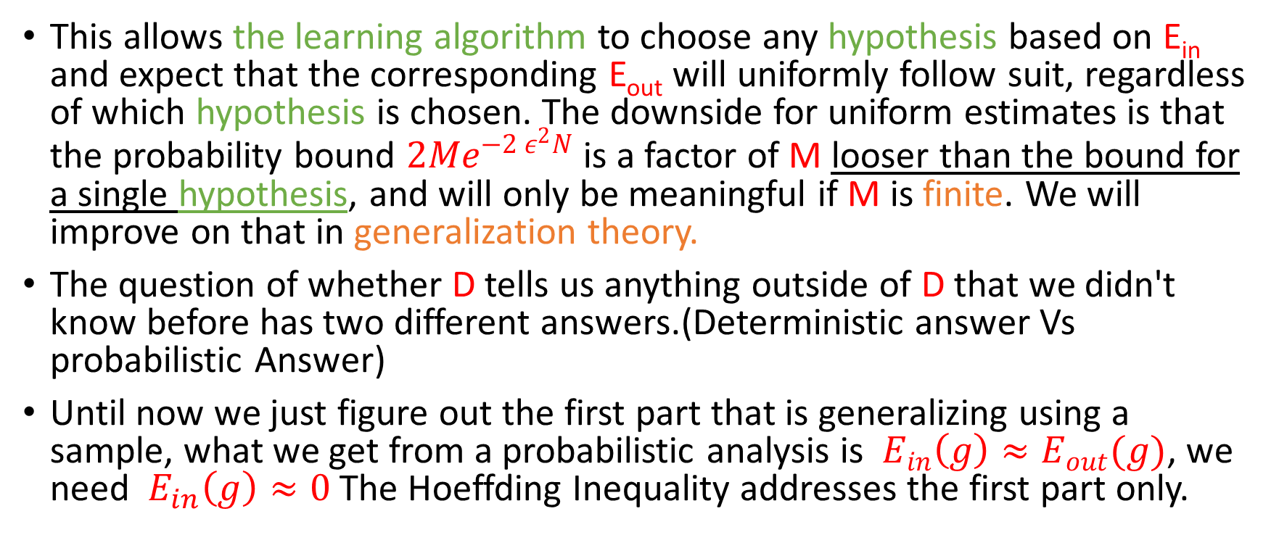
Conclusion
This allows the learning algorithm to choose any hypothesis based on E_{in} and expect that the corresponding E_{out} will uniformly follow suit, regardless of which hypothesis is chosen. The downside for uniform estimates is that the probability bound $2Me^{−2 ε^{2}N}$ is a factor of M looser than the bound for a single hypothesis, and will only be meaningful if M is finite. We will improve on that in generalization theory.
The question of whether D tells us anything outside of D that we didn't know before has two different answers.(Deterministic answer Vs probabilistic Answer)
Until now we just figure out the first part that is generalizing using a sample, what we get from a probabilistic analysis is $E_{in}\left(g\right)≈E_{out}(g)$, we need $E_{in}\left(g\right)≈0$ The Hoeffding Inequality addresses the first part only.

Slide 21
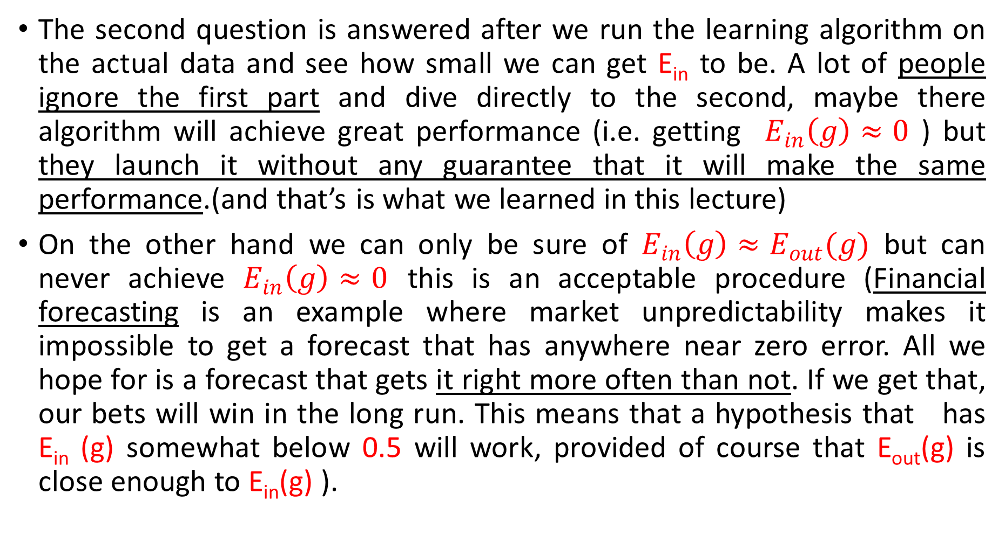
The second question is answered after we run the learning algorithm on the actual data and see how small we can get E_{in} to be. A lot of people ignore the first part and dive directly to the second, maybe there algorithm will achieve great performance (i.e. getting $E_{in}\left(g\right)≈0$ ) but they launch it without any guarantee that it will make the same performance.(and that’s is what we learned in this lecture)
On the other hand we can only be sure of $E_{in}\left(g\right)≈E_{out}(g)$ but can never achieve $E_{in}\left(g\right)≈0$ this is an acceptable procedure (Financial forecasting is an example where market unpredictability makes it impossible to get a forecast that has anywhere near zero error. All we hope for is a forecast that gets it right more often than not. If we get that, our bets will win in the long run. This means that a hypothesis that has E_{in} (g) somewhat below 0.5 will work, provided of course that E_{out}(g) is close enough to E_{in}(g) ).

